Slide 1
Game AI Hack: Pommerman IGGI Game Design II
Diego Perez Liebana and Simon Lucas
Game AI Research Group
Queen Mary University of London

Slide 2
On this menu
Pommerman, the game
Agents
The Hack

Slide 3
SFP & Pommerman
Focus: Statistical Forward Planning (SFP: MCTS & RHEA) algorithms on Pommerman:
Three game modes:
FFA: Free For All, 4x1, Full obs (/ PO)
Team (NIPS’18): 2vs2, PO
Team Radio: 2vs2, PO, Radio comm
All done in our own Java version of the game.

Slide 4
SFP & Pommerman
Challenges:
Dealing with multiple adversaries (competitive / collaborative)
Fog of war (depending on version)
Durative actions and tempral reasoning (e.g. bombs have a fuse delay)
Line-of-Sight considerations
Spatial reasoning (the exact layout of the hard and soft walls is of key importance)

Slide 5
Pommerman: the game

Slide 6
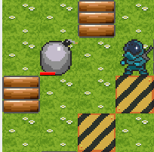
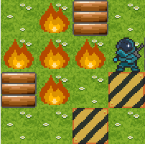





Game Description
Randomly drawn symmetric 11x11 grid
4 players, 3 modes
Players can place bombs that explode after 10 ticks.
Bombs generate flames in a cross (size 1). They kill players, wood and explode other bombs.
Players can’t put more than one bomb at a time.
Obstacles: Wood (destroyable by flames) and Rigid (fixed) blocks
Pick-up Items:
Hidden in Wood obstacles.
Extra bomb: adds one to the limit of bombs a player can drop.
Increment Range: adds one to the size of the explosion.
Kick: allows kicking a bomb on collision, in a straight line distance in the direction of travel.
Game lasts N ticks or until a player / team wins

Slide 7
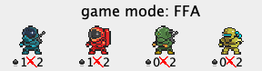
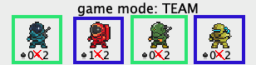
Game Modes
Free For All (FFA): 4 players competing all against each other
Last player standing wins
All players that die lose the game
Players that alive at the end tie
Last players die on the same tick, they also tie
Team: 4 players competing in teams of 2
Always paired 1-3, 2-4, sited in opposite corners
Team with no agents loses, other team wins
Players of each team alive at the end, teams tie
Last players of each team die on same tick, teams tie
Team Radio:
As Team but adding a layer of communication

Slide 8
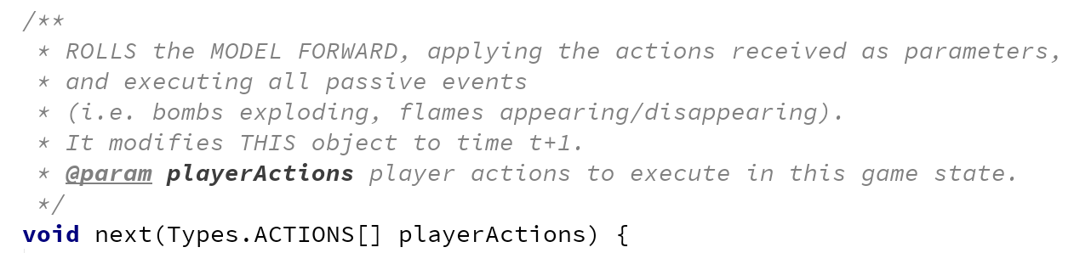
Game State + Forward Model
Game State
The objective state of the game
The state of the game as observed by an agent
Contains a Forward Model object
Forward Model
Information about bombs, agents, walls, powerups
Handles updates to the game state
collisions
explosions
actions

Slide 9
Pommerman Framework
Code: https://github.com/GAIGResearch/java-pommerman
Wiki: https://github.com/GAIGResearch/java-pommerman/wiki
core - Package contains core game classes and some *Test.java classes running unit tests on various functionality.
Game.java - Contains main game functionality (i.e. running instances of games)
GameState.java - Contains all information for a game state, including a ForwardModel object. It's used by the agents to interact with the game.
ForwardModel.java - Contains main engine functionality for advancing a state.
gameConfig - Package contains game configuration objects which define victory conditions

Slide 10
Game.java
public class Game { private GameLog gameLog; private GameState[] gameStateObservations; private ArrayList<Player> players; private Types.GAME_MODE gameMode; private long seed; private int size;
//…
public Types.RESULT[] run(GUI frame, WindowInput wi, boolean separateThreads)
void tick (boolean separateThreads)
//…
}

Slide 11
GameState.java
public class GameState { private int nActions = NUM_ACTIONS; ForwardModel model;
private Avatar avatar;
private int playerIdx;
private int tick;
//…
public boolean next(Types.ACTIONS[] actions)
public GameState copy()
public boolean isTerminal()
public int getTick()
public int nActions()
// Many game state information methods… https://github.com/GAIGResearch/java-pommerman/wiki/Creating-an-AI-Player
}

Slide 12
ForwardModel.java
public class ForwardModel {
private Types.TILETYPE[][] board;
private int[][] bombBlastStrength;
private int[][] bombLife;
private Types.TILETYPE[][] powerups;
private GameObject[] agents;
private ArrayList<GameObject> aliveAgents; private ArrayList<GameObject> flames; private ArrayList<GameObject> bombs;
void init(…)
void next(Types.ACTIONS[] playerActions)
private void translatePlayerActions()

Slide 13
gameConfig.OriginalGameConfig.java
This interface provides the possibility of defining different team configurations for Pommerman (IGameConfig.java)
Defines who are the teammates and the enemies
When is the game ended and which ones are the winning conditions
Decides the rewards for the agents given by the game.

Slide 14
How to run it
Test.java:
Run.runGame(game, ki1, ki2, useSeparateThreads);
if (game.isLogged()){ Game replay = Game.getLastReplayGame(); Run.runGame(replay, ki1, ki2, useSeparateThreads); }
int N = 20; Run.runGames(game, new long[]{seed}, N, useSeparateThreads);
https://github.com/GAIGResearch/java-pommerman/wiki/Java-Framework-%28How-to-Run%29

Slide 15
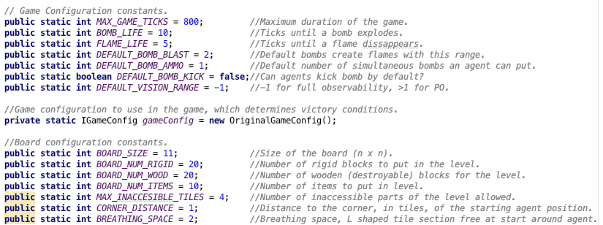
Types.java
utils.Types.java
Tile types, sprites, game modes, results, actions and directions.
Game Parameters (including GameConfig)

Slide 16
objects package
objects - Package contains definitions for all game objects
GameObject.java - Defines generic game objects with a given type.
Flame.java - Defines flames for the game. Extends on GameObject by adding a time to live variable.
Bomb.java - Defines bombs for the game. Has a time to live variable, and a velocity. Handles bomb explosions. It updates its desired position on every game tick based on its velocity.
Avatar.java - Defines avatars for the game and all their properties, including playerID (for connection to AI player), kick ability, ammo, bomb blast strength, vision range, win status (win, loss, tie, incomplete), enemies, teammates and team ID. Handles property modifications based on power-up collection.

Slide 17
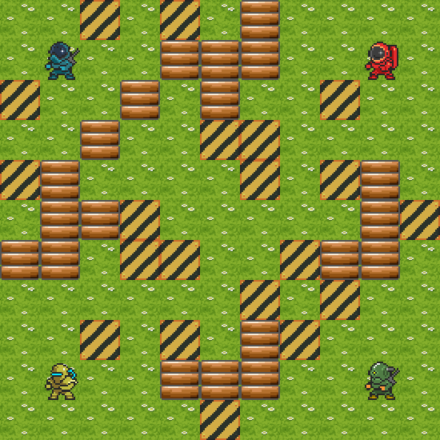





Board Generation
Agents:
Passage:
Rigid:
Wood:
Board Logic:
Square
Diagonally symmetric
Agents have initial breathing space
Agents can reach each other
A typical board

Slide 18
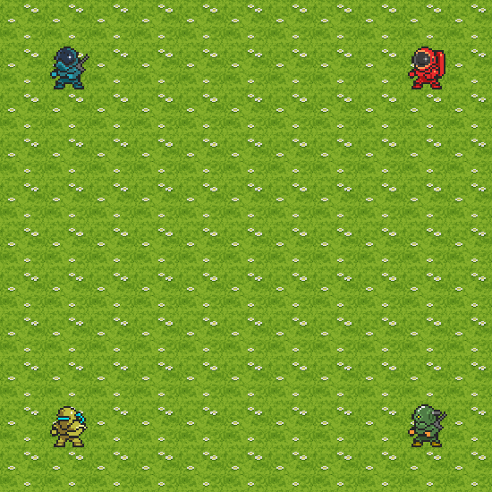
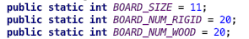
Board Generation
Place agents, and allocate breathing space.
Utils.Types.java

Slide 19
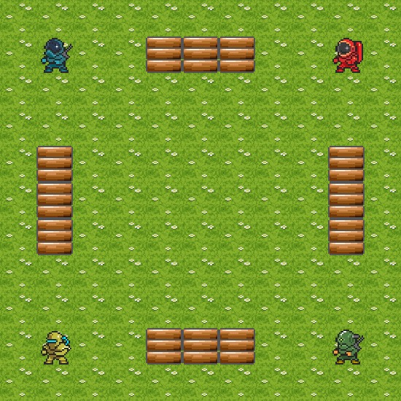
Board Generation
Place agents, and allocate breathing space.
Place WOOD tiles to construct guaranteed passages between agents.

Slide 20
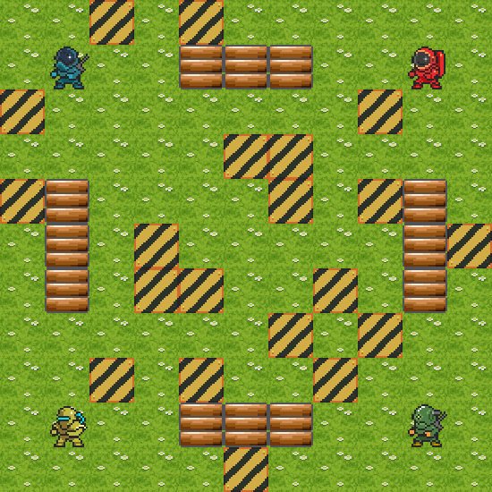
Board Generation
Place agents, and allocate breathing space.
Place WOOD tiles to construct guaranteed passages between agents.
Place N (parametrized) RIGID tiles randomly (and symmetrically)

Slide 21
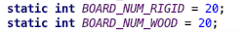
Board Generation
Place agents, and allocate breathing space.
Place WOOD tiles to construct guaranteed passages between agents.
Place N (parametrized) RIGID tiles randomly (and symmetrically)
Place M (parametrized) WOOD tiles randomly (and symmetrically)
Utils.Types.java

Slide 22

Board Generation
Place agents, and allocate breathing space.
Place WOOD tiles to construct guaranteed passages between agents.
Place N (parametrized) RIGID tiles randomly (and symmetrically)
Place M (parametrized) WOOD tiles randomly (and symmetrically)
Check the number of inaccessible passages.
Utils.Types.java

Slide 23

Board Generation
Place agents, and allocate breathing space.
Place WOOD tiles to construct guaranteed passages between agents.
Place N (parametrized) RIGID tiles randomly (and symmetrically)
Place M (parametrized) WOOD tiles randomly (and symmetrically)
Check the number of inaccessible passages.
Place power-up objects.
Utils.Types.java

Slide 24
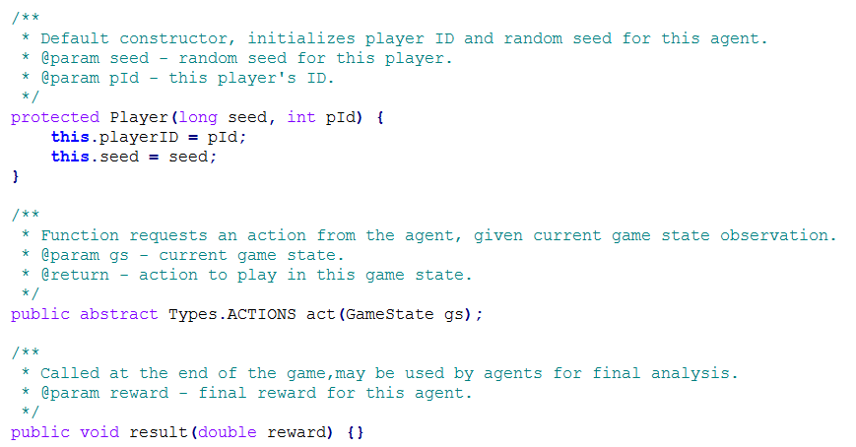
AI Agent API
Must extend abstract class Player
Action space:
STOP
UP
DOWN
LEFT
RIGHT
PLACE BOMB

Slide 25
Partial Observability
States assigned avatars & state observations reduced in ForwardModel.copy() based on the vision range and avatar’s position
Any objects outside the vision range are replaced with a Fog type and are not updated by engine during simulations
GUI displays true game state + views of all individual agents
Different measures can be used to achieve different observations (square view in original Pommerman)

Slide 26
Agents https://github.com/GAIGResearch/java-pommerman/wiki/AI-Players

Slide 27
Very simple
Do Nothing: always returns action STOP (does nothing)
players.DoNothingPlayer.java
public class DoNothingPlayer extends Player {
public DoNothingPlayer(int pId) { super(0, pId); }
public Types.ACTIONS act(GameState gs) { return Types.ACTIONS.ACTION_STOP; }
public Player copy() { return new DoNothingPlayer(playerID); }
}

Slide 28
Very simple
Random: returns a random action out of those available
players.RandomPlayer.java
public class RandomPlayer extends Player { private Random random; public RandomPlayer(long seed, int id) { super(seed, id); random = new Random(seed); } public Types.ACTIONS act(GameState gs) { int actionIdx = random.nextInt(gs.nActions()); return Types.ACTIONS.all().get(actionIdx); } public Player copy() { return new RandomPlayer(seed, playerID); } }

Slide 29
Very simple
Game state
One Step Look Ahead:
checks the result of all available actions
advances game state once with each action using the Forward Model
uses a DoNothing opponent model (considers opponents do nothing in its simulations)
evaluates states using a heuristic (minimizes the number of opponents in the game)
chooses action with best immediate outcome (short-sighted)
players.OSLAPlayer.java

Slide 30
Simple Agent
Taken from the original framework (simple_agent.py)
Follows hand designed set of rules.
Uses Dijkstra’s pathfinding algorithm.
Serves as a baseline agent.
“This agent is prone to killing itself.”
players.SimplePlayer.java

Slide 31
Simple Agent
At each step, the agent receives GameState; then performs Dijkstra’s pathfinding with a limited depth (10). Makes decisions following these rules:
If there are any upcoming bomb explosions; escape.
If adjacent to an enemy; lay a bomb.
If there is an enemy within 3 steps; move towards it.
If there is a power-up within 2 steps; move towards it.
If adjacent to a WOOD tile; lay a bomb.
If there is a WOOD tile within 2 steps and we have ammo; move towards it.
Move randomly to a not recently visited position.

Slide 32
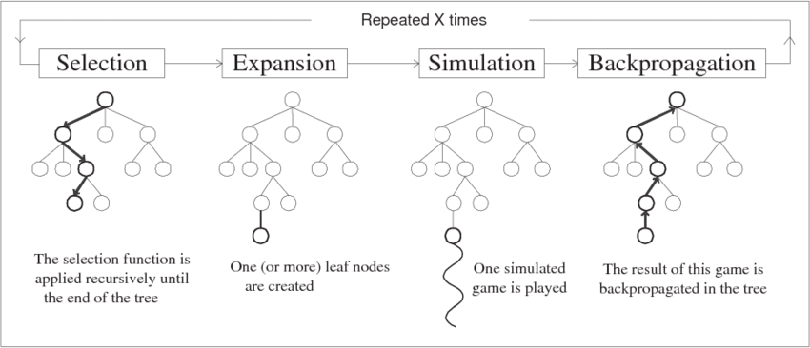
MCTS (players.mcts.MCTSPlayer.java)

Slide 33
Rolling Horizon Evolution Agents
SimpleEvoAgent: players.SimpleEvoAgent.java
RHEA: players.rhea.RHEAPlayer.java

Slide 34
Heuristics
Used for evaluating non-terminal states.
Hand-tuned, as weighted linear combinations.
Two types:
Basic (directly available, no computational overhead)
Advanced (computed, Dijkstra’s pathfinding)
Basic Heuristics:
Number of alive teammates/enemies.
Number of different tile types such as WOOD.
Avatar’s properties: Kicking, Ammo, Max Ammo, Blast Strength
players.heuristics.CustomHeuristic.java

Slide 35
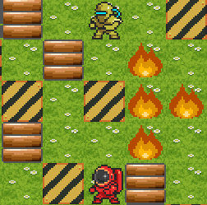
Heuristics
Advanced Heuristics:
Number of directions in (upcoming) bomb explosions
Number of safe directions (passable, not getting the agent stuck)
Distance to enemies
Distance to power-up(s)
players.heuristics.AdvancedHeuristic.java

Slide 36
Tuning agents
Agents have many parameters and possible combinations of parameters (including different heuristic options):
MCTS: 3 parameters, 3.000E1 search space
RHEA: 26 parameters, 1.741E12 search space (13 non-dependent params, 7.465E6 sp)
NTBEA integration:
Common ParameterSet interface for all parameterized agents
Can be tuned with NTBEA for better performance against certain opponents
https://github.com/GAIGResearch/java-pommerman/wiki/Optimizing-Agent-Parameters

Slide 37
Pommerman: the hack
Notes:
VISION RANGE = 4
FFA
MCTS OSLA OSLA OSLA - 0 100 6 2 2 2
RHEA OSLA OSLA OSLA - 0 100 4 2 2 2
MCTS-Adv OSLA OSLA OSLA - 0 100 7 2 2 2
RHEA-Adv OSLA OSLA OSLA - 0 100 5 2 2 2
MCTS SimpleAI SimpleAI SimpleAI - 0 100 6 3 3 3
RHEA SimpleAI SimpleAI SimpleAI - 0 100 4 3 3 3
MCTS-Adv SimpleAI SimpleAI SimpleAI - 0 100 7 3 3 3
RHEA-Adv SimpleAI SimpleAI SimpleAI - 0 100 5 3 3 3
MCTS RHEA RHEA RHEA - 0 100 6 4 4 4
MCTS-Adv RHEA RHEA RHEA - 0 100 7 4 4 4
MCTS RHEA-Adv RHEA-Adv RHEA-Adv - 0 100 6 5 5 5
RHEA MCTS MCTS MCTS - 0 100 4 6 6 6
RHEA-Adv MCTS MCTS MCTS - 0 100 5 6 6 6
RHEA MCTS-Adv MCTS-Adv MCTS-Adv - 0 100 4 7 7 7
TEAM (default range)
MCTS OSLA MCTS OSLA - 1 100 6 2 6 2
RHEA OSLA RHEA OSLA - 1 100 4 2 4 2
MCTS SimpleAI MCTS SimpleAI - 1 100 6 3 6 3
RHEA SimpleAI RHEA SimpleAI - 1 100 4 3 4 3
MCTS RHEA MCTS RHEA - 1 100 6 4 6 4
RHEA MCTS RHEA MCTS - 1 100 4 6 4 6
VISION RANGE = -1
FFA
MCTS OSLA OSLA OSLA - 0 100 -1 6 2 2 2
RHEA OSLA OSLA OSLA - 0 100 -1 4 2 2 2
MCTS-Adv OSLA OSLA OSLA - 0 100 -1 7 2 2 2
MCTS SimpleAI SimpleAI SimpleAI - 0 100 -1 6 3 3 3
RHEA SimpleAI SimpleAI SimpleAI - 0 100 -1 4 3 3 3
MCTS-Adv SimpleAI SimpleAI SimpleAI - 0 100 -1 7 3 3 3
MCTS RHEA RHEA RHEA - 0 100 -1 6 4 4 4
MCTS-Adv RHEA RHEA RHEA - 0 100 -1 7 4 4 4
RHEA MCTS MCTS MCTS - 0 100 -1 4 6 6 6
TEAM (default range)
MCTS OSLA MCTS OSLA - 1 100 -1 6 2 6 2
RHEA OSLA RHEA OSLA - 1 100 -1 4 2 4 2
MCTS SimpleAI MCTS SimpleAI - 1 100 -1 6 3 6 3
RHEA SimpleAI RHEA SimpleAI - 1 100 -1 4 3 4 3
MCTS RHEA MCTS RHEA - 1 100 -1 6 4 6 4
RHEA MCTS RHEA MCTS - 1 100 -1 4 6 4 6
VISION RANGE = 2 (TODO)
FFA
MCTS OSLA OSLA OSLA - 0 100 2 6 2 2 2
RHEA OSLA OSLA OSLA - 0 100 2 4 2 2 2
MCTS-Adv OSLA OSLA OSLA - 0 100 2 7 2 2 2
MCTS SimpleAI SimpleAI SimpleAI - 0 100 2 6 3 3 3
RHEA SimpleAI SimpleAI SimpleAI - 0 100 2 4 3 3 3
MCTS-Adv SimpleAI SimpleAI SimpleAI - 0 100 2 7 3 3 3
MCTS RHEA RHEA RHEA - 0 100 2 6 4 4 4
MCTS-Adv RHEA RHEA RHEA - 0 100 2 7 4 4 4
RHEA MCTS MCTS MCTS - 0 100 4 6 6 6
TEAM (default range)
MCTS OSLA MCTS OSLA - 1 100 2 6 2 6 2
RHEA OSLA RHEA OSLA - 1 100 2 4 2 4 2
MCTS SimpleAI MCTS SimpleAI - 1 100 2 6 3 6 3
RHEA SimpleAI RHEA SimpleAI - 1 100 2 4 3 4 3
MCTS RHEA MCTS RHEA - 1 100 2 6 4 6 4
RHEA MCTS RHEA MCTS - 1 100 2 4 6 4 6

Slide 38
Aims of the AI Hack
Produce interesting variants of Pommerman
Each group produces their own variation
Produce strong AI players that can with the tournaments

Slide 39
What you must respect to keep it all working and nice
Don’t change the Agent AI API
Your agent should still play in real time.
Let’s say, return an action every 100ms

Slide 40
Setting up tournaments
4 groups
We suggest round robin tournaments
i.e. run like a football league (except with more game repetitions)
4 bots plays each other:
N times (suggest N = 20)
On each turf (x4)
Two different observability modes: Full and PO:4 (x2)
We will provide 20 seeds (secret) to play these games

